Slide 1
21
Bits, Characters,
C-Strings and
structs

Slide 2
The same old charitable lie Repeated as the years scoot by Perpetually makes a hit—
“You really haven’t changed a bit!”
  Margaret Fishback
The chief defect of Henry King Was chewing little bits of string.
  Hilaire Belloc
Vigorous writing is concise. A sentence should
contain no unnecessary words, a paragraph no unnecessary sentences.
  William Strunk, Jr.

Slide 3
OBJECTIVES
In this chapter you’ll learn:
To create and use structs.
To pass structs to functions by value and by reference.
To use typedef to create aliases for previously defined data types and structs.
To manipulate data with the bitwise operators and to create bit fields for storing data compactly.
To use the functions of the character- handling library <cctype>.
To use the string-conversion functions of the general-utilities library <cstdlib>.
To use the string-processing functions of the string-handling library <cstring>.

Slide 4
21.1 Introduction
21.2 Structure Definitions
21.3 Initializing Structures
21.4 Using Structures with Functions
21.5 typedef
21.6 Example: High-Performance Card Shuffling and Dealing Simulation
21.7 Bitwise Operators
21.8 Bit Fields
21.9 Character-Handling Library
21.10 Pointer-Based String-Conversion Functions
21.11 Search Functions of the Pointer-Based String-Handling Library
21.12 Memory Functions of the Pointer-Based String-Handling Library
21.13 Wrap-Up

Slide 5
21.1 Introduction
Structures
  Similar to classes
    Can contain access specifiers, member functions, constructors and destructors
    Only difference is that structure members are public by default (class members are private by default)
Bitfields
  Can specify the exact number of bits to use for a variable
C-style string manipulation functions
  Process blocks of memory as arrays of bytes

Slide 6
21.2 Structure Definitions
Structures
  Aggregate data types
    Built using elements of several types

Slide 7
21.2 Structure Definitions (Cont.)
Structures (Cont.)
  Example
    struct Card
    {
    char *face;
    char *suit;
    };
  Keyword struct
  Structure name Card
    Used to declare variables of the structure type
  Data members face and suit
    Must have unique names
  Ending semicolon like a class

Slide 8
Common Programming Error 21.1
Forgetting the semicolon that terminates a structure definition is a syntax error.

Slide 9
21.2 Structure Definitions (Cont.)
Structures (Cont.)
  Structure cannot contain an instance of itself
    Can contain a pointer to an instance of itself (self-referential)
  Can declare variables of the structure type as a comma-separated list of variable names between structure’s closing brace and semicolon
  Structure name is optional
    Variables of unnamed structures can be declared only by placing them after structure definition and before semicolon

Slide 10
Software Engineering Observation 21.1
Provide a structure name when creating a structure type. The structure name is required for declaring new variables of the structure type later in the program, declaring parameters of the structure type and, if the structure is being used like a C++ class, specifying the name of the constructor and destructor.

Slide 11
21.2 Structure Definitions (Cont.)
Structures (Cont.)
  Built-in operations that may be performed on structure objects
    Assignment operator =
    Address operator &
    Member-access operators . and ->
    sizeof operator
    Other operators can be overloaded to work with any structure

Slide 12
21.2 Structure Definitions (Cont.)
Structures (Cont.)
  “Holes” in a structure
    Because some computers store data types only on certain memory boundaries
    Structure members are not necessarily stored in consecutive memory locations

Slide 13
Common Programming Error 21.2
Comparing structures is a compilation error.

Slide 14

Fig. 21.1 | Possible storage alignment for a variable of type Example, showing an undefined area in memory.

Slide 15
Portability Tip 21.1
Because the size of data items of a particular type is machine dependent, and because storage alignment considerations are machine dependent, so too is the representation of a structure.

Slide 16
21.3 Initializing Structures
Initializing a structure
  Structures can be initialized using initializer lists
    Example
      Card oneCard = { "Three", "Hearts" };
        Initializes member face to "Three"
        Initializes member suit to "Hearts"
    If there are fewer initializers than members
      Remaining members are initialized to default values
  Structure variables declared outside any function are initialized to default values
  Structure variables may also be initialized by
    Assigning a structure variable of the same type
    Assigning to individual members

Slide 17
21.4 Using Structures with Functions
Passing structures to functions
  Entire structure or individual members can be passed to functions
  Structures are passed by value, by default
    To pass a structure by reference
      Pass address of the structure object
      Pass reference to the structure object
      Pass array of structure objects
  To pass an array by value
    Encapsulate it inside a structure, which is passed by value

Slide 18
Performance Tip 21.1
Passing structures (and especially large structures) by reference is more efficient than passing them by value (which requires the entire structure to be copied).

Slide 19
21.5 typedef
Keyword typedef
  Used for creating synonyms for previously defined data types
    Often defined to create shorter, simpler or more readable type names
  Example
    typedef Card *CardPtr;
      Defines type name CardPtr as a synonym for Card *
  Does not create a new type
    Only a new type name that can be used as an alias for an existing type name
–

Slide 20
Good Programming Practice 21.1
Capitalize typedef names to emphasize that these names are synonyms for other type names.

Slide 21
Portability Tip 21.2
Synonyms for built-in data types can be created with typedef to make programs more portable. For example, a program can use typedef to create alias Integer for four-byte integers. Integer can then be aliased to int on systems with four-byte integers and can be aliased to long int on systems with two-byte integers where long int values occupy four bytes. Then, the programmer simply declares all four-byte integer variables to be of type Integer.

Slide 22
21.6 Example: High-Performance Card Shuffling and Dealing Simulation
–

Slide 23
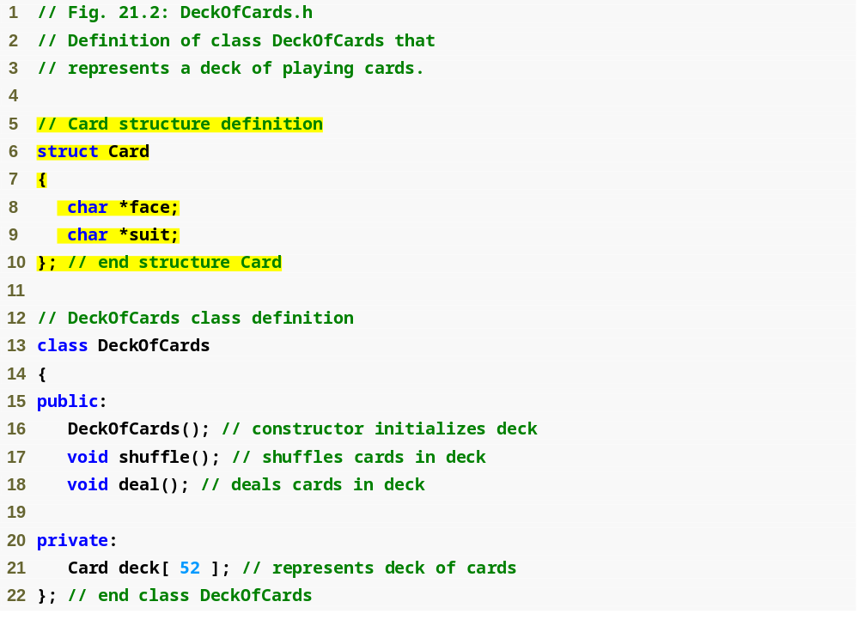
Outline
DeckOfCards.h
(1 of 1)
Define structure Card
Class DeckOfCards contains an array of Card structure objects

Slide 24
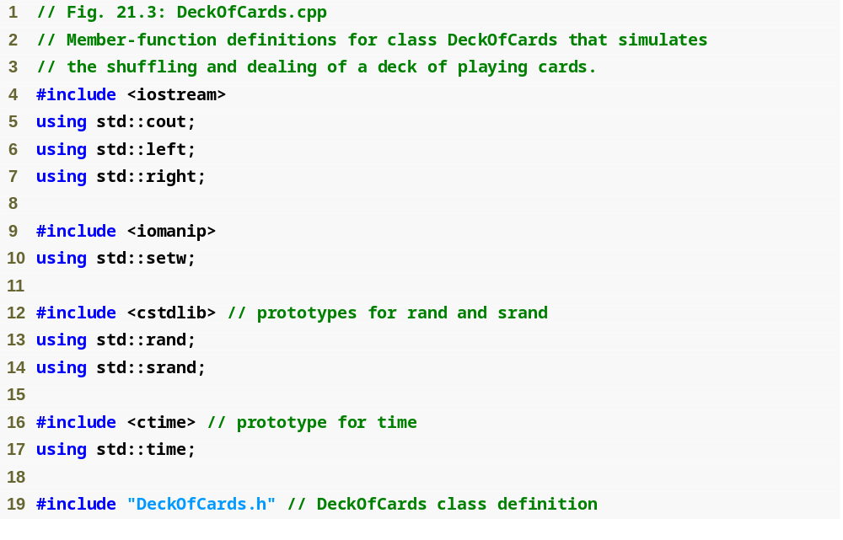
Outline
DeckOfCards.cpp
(1 of 3)

Slide 25
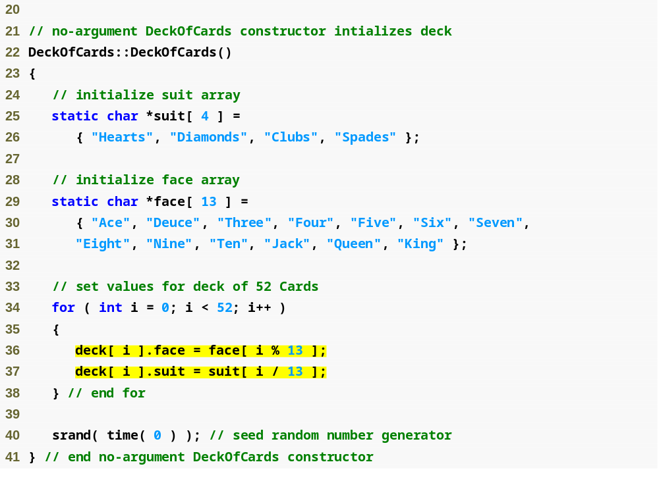
Outline
DeckOfCards.cpp
(2 of 3)
Initialize Card members by assignment

Slide 26
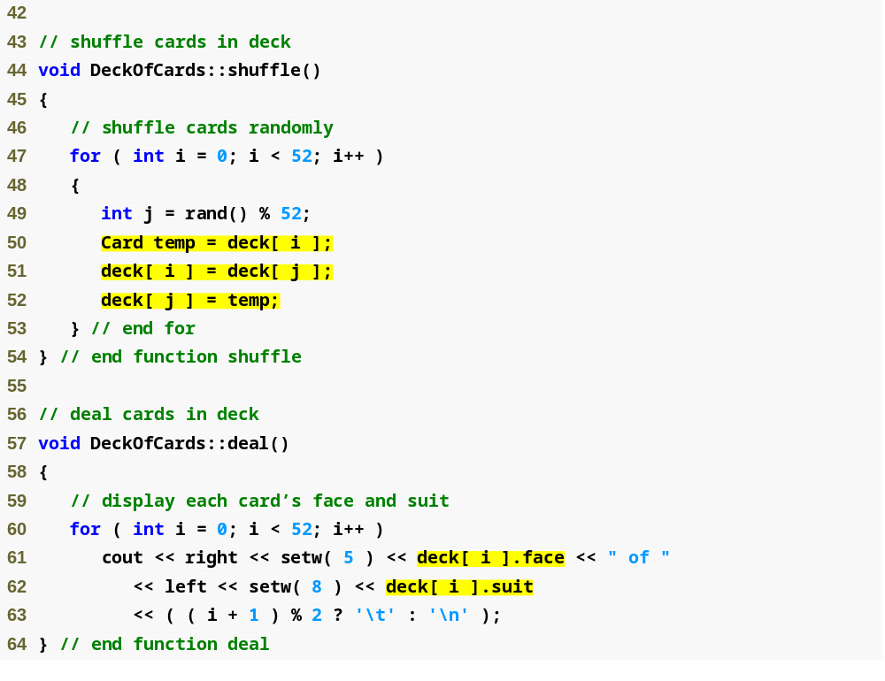
Outline
DeckOfCards.cpp
(3 of 3)
Shuffle cards by performing 52 swaps in a single pass of the array

Slide 27
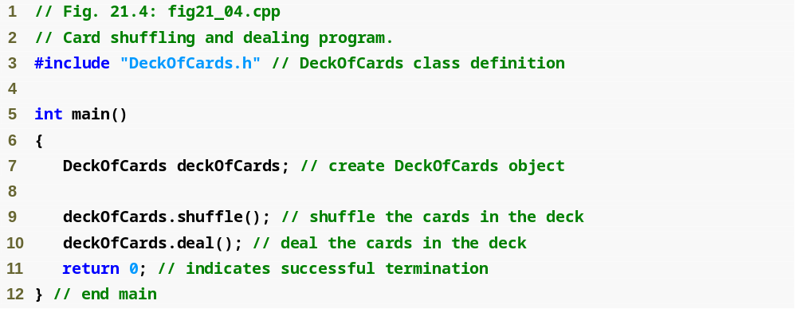
Outline
fig21_04.cpp
(1 of 2)

Slide 28
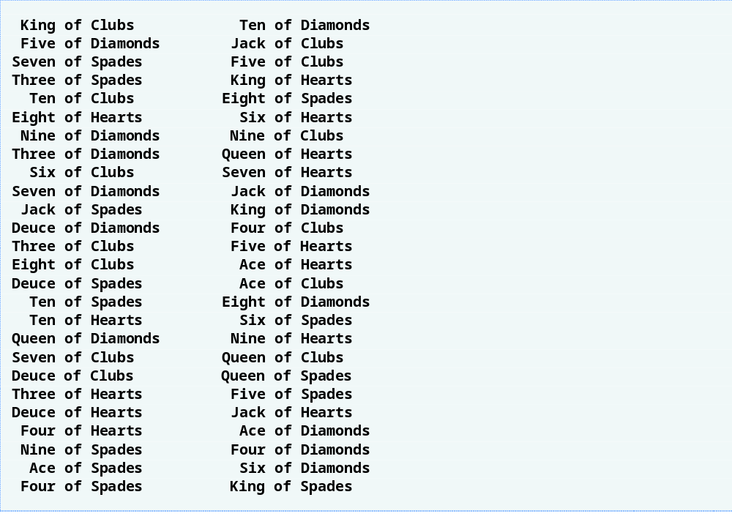
Outline
fig21_04.cpp
(2 of 2)

Slide 29
21.7 Bitwise Operators
Bitwise manipulations
  Used to manipulate the bits of integral operands
    Usually unsigned integers
Bitwise operators
  Bitwise AND (&)
    Sets each bit in result to 1 if corresponding bit in both operands is 1
  Bitwise inclusive OR (|)
    Sets each bit in result to 1 if corresponding bit in either (or both) operand(s) is 1
  Bitwise exclusive OR (^)
    Sets each bit in result to 1 if corresponding bit in either operand–but not both–is 1

Slide 30
21.7 Bitwise Operators (Cont.)
Bitwise operators (Cont.)
  Left shift (<<)
    Shifts bits of left operand to the left by number of bits specified in right operand
      Bits vacated to the right are replaced with 0s
      1s shifted off the left are lost
  Right shift (>>)
    Shifts bits in left operand to the right by number of bits specified in right operand
      Bits vacated to the left
        Replaced with 0s for an unsigned integer
        Machine-dependent for a signed integer
      1s shifted off the right are lost

Slide 31
21.7 Bitwise Operators (Cont.)
Bitwise operators (Cont.)
  Bitwise complement (~)
    Sets all 0 bits in operand to 1 in result and sets all 1 bits in operand to 0 in result
  Bitwise assignment operators
    Bitwise AND assignment operator &=
    Bitwise inclusive-OR assignment operator |=
    Bitwise exclusive-OR assignment operator ^=
    Left-shift assignment operator <<=
    Right-shift with sign extension assignment operator >>=
    (no bitwise complement assignment operator)

Slide 32
Portability Tip 21.3
Bitwise data manipulations are machine dependent.

Slide 33
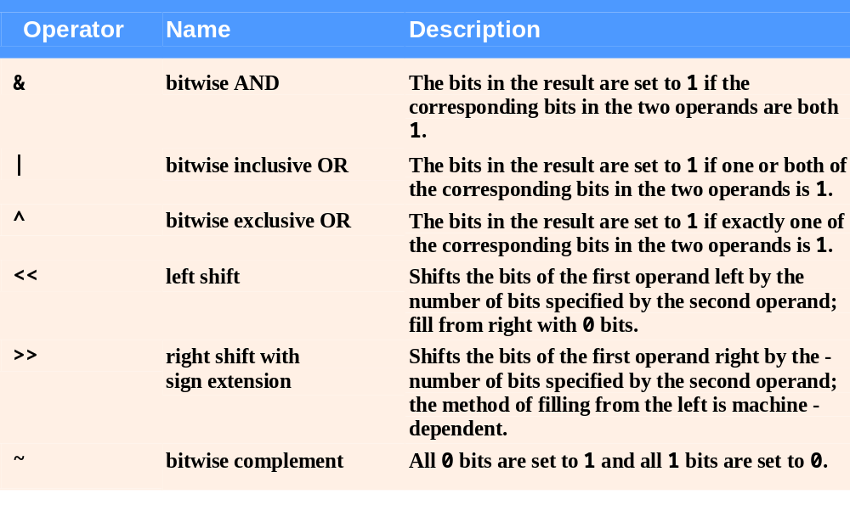
Fig. 21.5 | Bitwise operators.

Slide 34
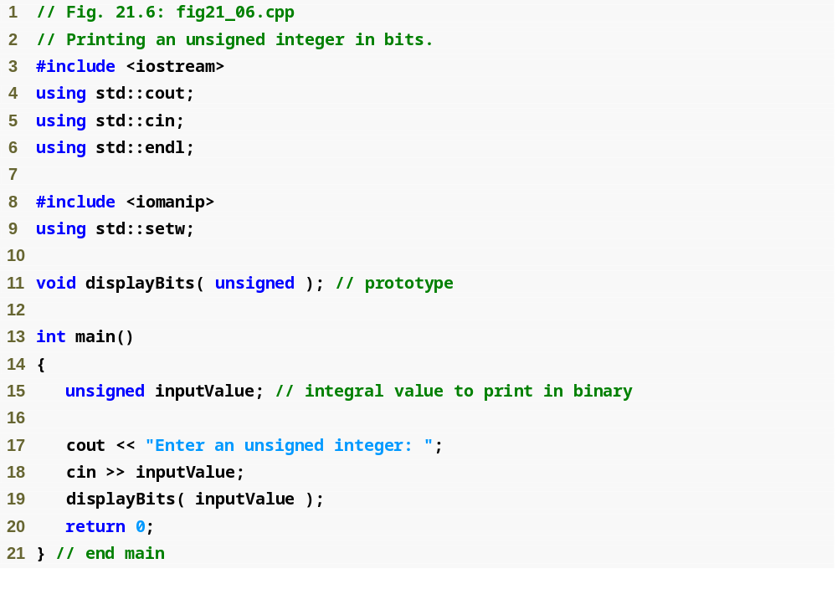
Outline
fig21_06.cpp
(1 of 2)

Slide 35
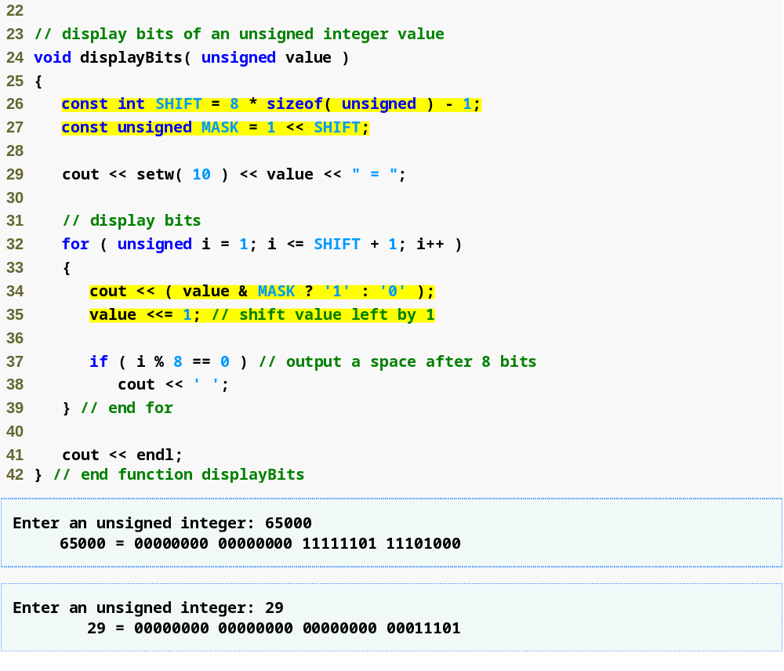
Outline
The value of constant SHIFT is 1 less than the total number of bits required to store an unsigned object
Assign constant MASK the value 1 << SHIFT, which has a 1 in the leftmost bit and 0s filled to the right
fig21_06.cpp
(2 of 2)
Determine whether a 1 or a 0 should be printed for the current leftmost bit of variable value
Shift variable value left by 1 bit so we can display the next bit over

Slide 36
21.7 Bitwise Operators (Cont.)
Mask operand
  An integer value with specific bits set to 1
  Used to hide some bits in a value while selecting other bits
  Examples
    00000000 11101000 (value)
    10000000 00000000 (MASK)
    ----------------- perform bitwise AND operation
    00000000 00000000 (value & MASK)
    11101000 00000000 (value)
    10000000 00000000 (MASK)
    ----------------- perform bitwise AND operation
    10000000 00000000 (value & MASK)

Slide 37
Common Programming Error 21.3
Using the logical AND operator (&&) for the bitwise AND operator (&) and vice versa is a logic error.

Slide 38
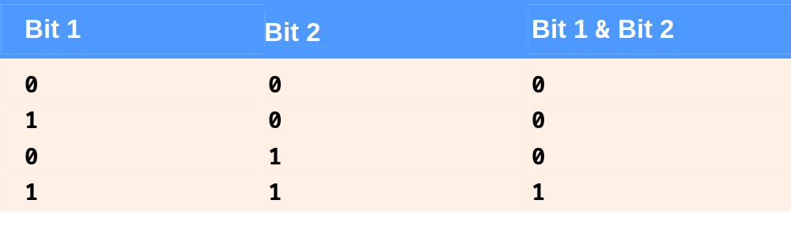
Fig. 21.7 | Results of combining two bits with the bitwise AND operator (&).

Slide 39
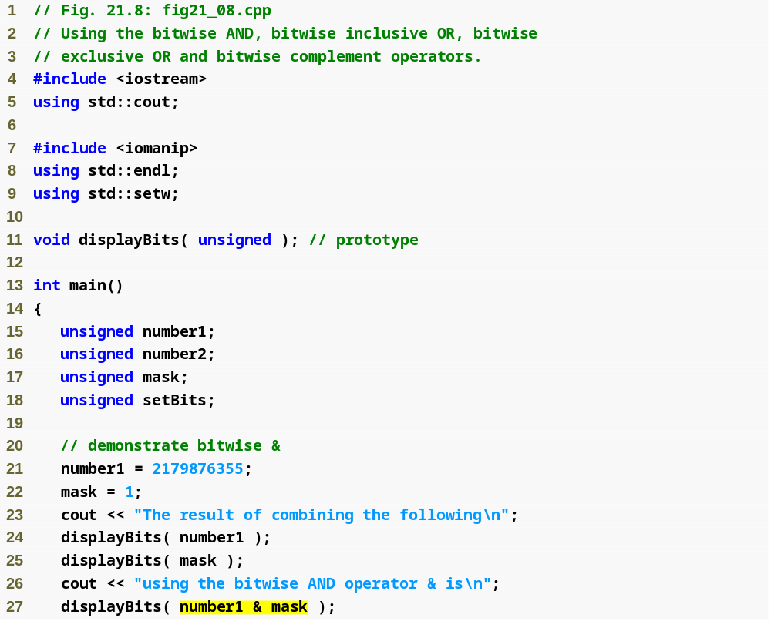
Outline
fig21_08.cpp
(1 of 4)
Assign 10000001 11101110 01000110 00000011 to number1
Assign 00000000 00000000 00000000 00000001 to mask
All the bits except the low-order bit in variable number1 are “masked off” (hidden) by “ANDing” with constant MASK

Slide 40
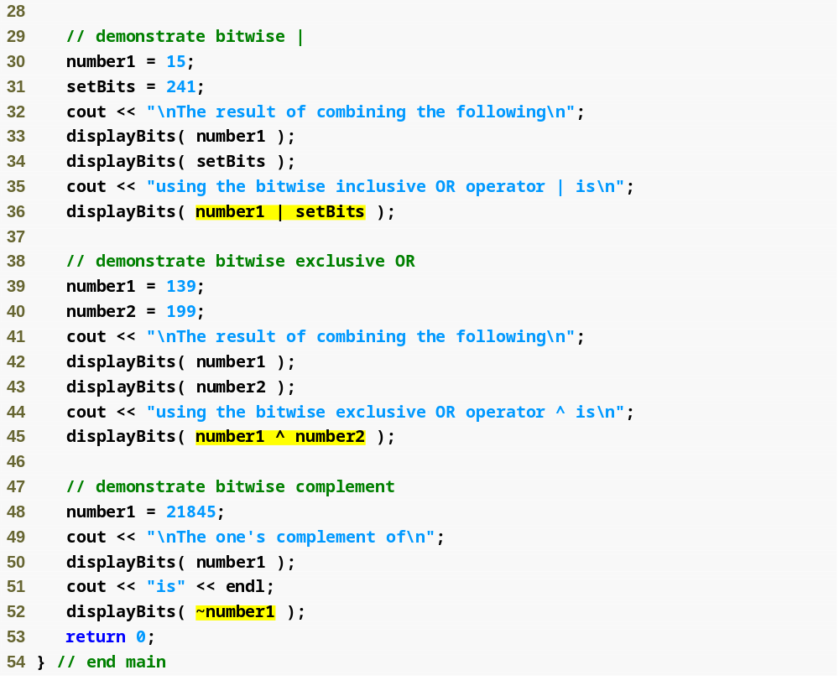
Outline
fig21_08.cpp
(2 of 4)
Combine number1 and setBits using the bitwise OR operator in the expression number1 | setBits
Combine number1 and number2 with the exclusive-OR operator in the expression number1 ^ number2
“Take the one’s complement” of variable number1 with expression ~number1

Slide 41
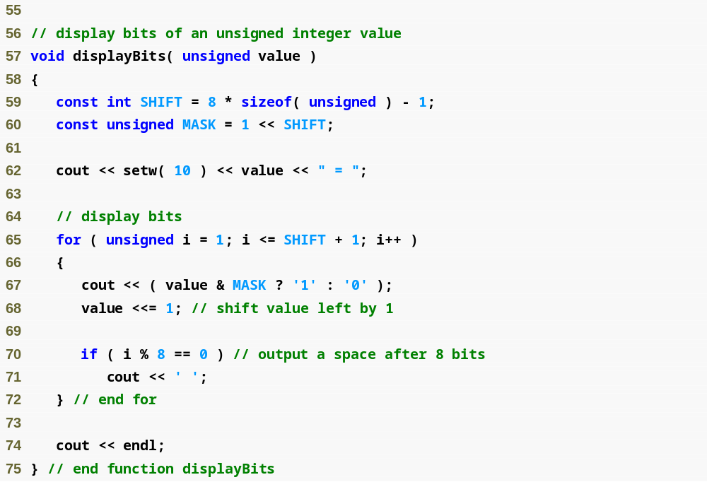
Outline
fig21_08.cpp
(3 of 4)

Slide 42
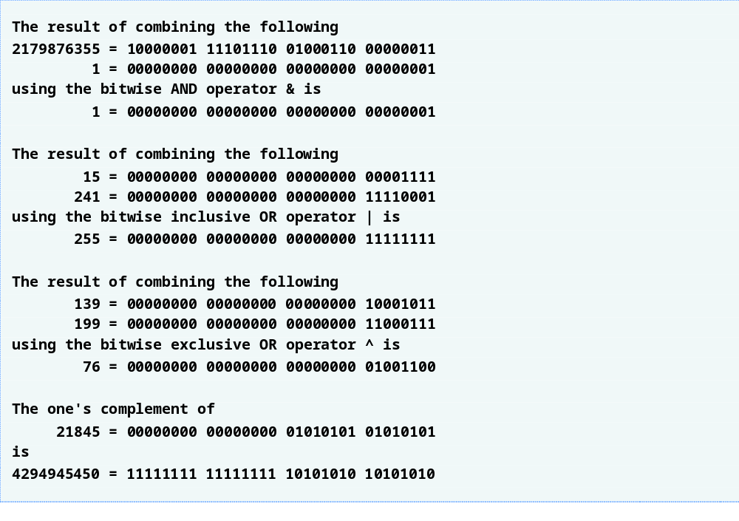
Outline
fig21_08.cpp
(4 of 4)

Slide 43
Common Programming Error 21.4
Using the logical OR operator (||) for the bitwise OR operator (|) and vice versa is a logic error.

Slide 44
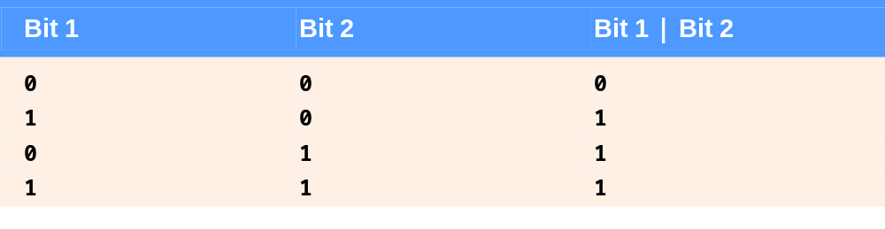
Fig. 21.9 | Combining two bits with the bitwise inclusive-OR operator (|).

Slide 45
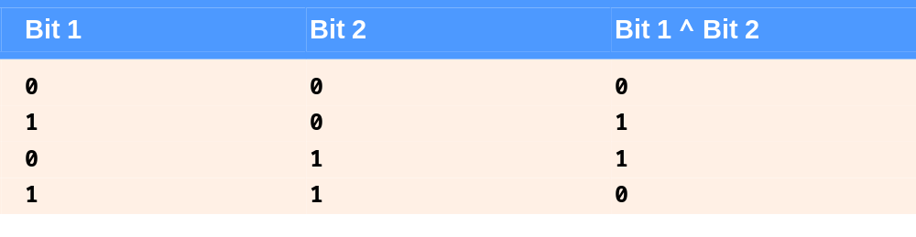
Fig. 21.10 | Combining two bits with the bitwise exclusive-OR operator (^).

Slide 46
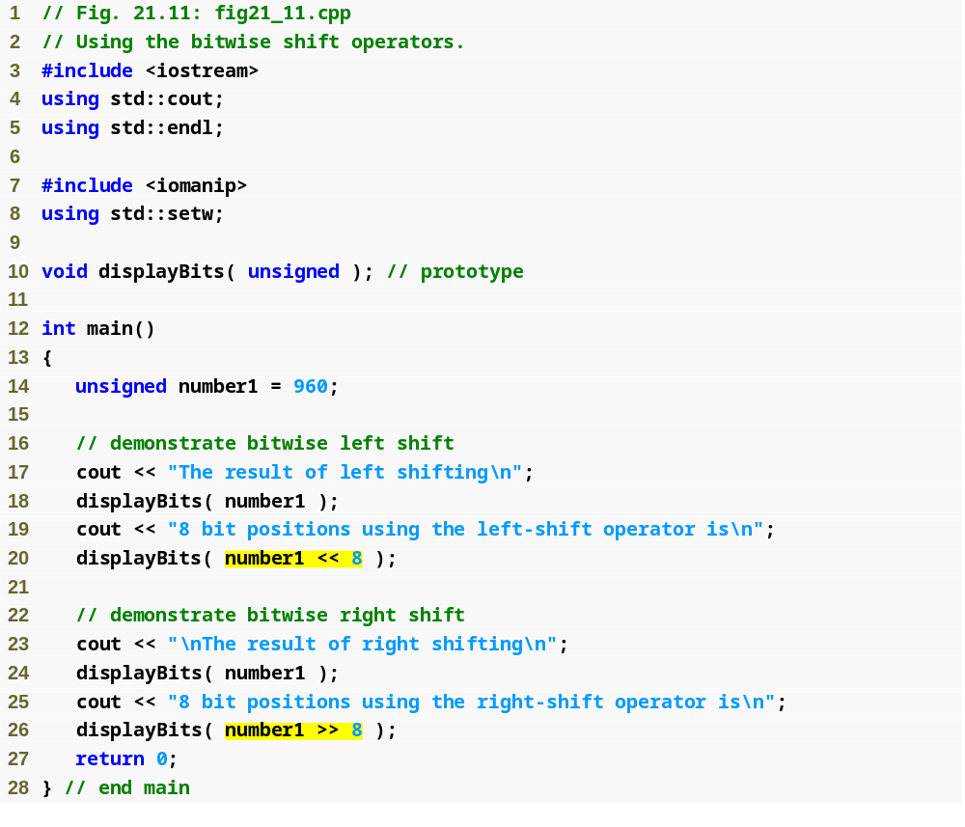
Outline
fig21_11.cpp
(1 of 3)
Left-shift variable number1 by 8 bits
Right-shift variable number1 by 8 bits

Slide 47
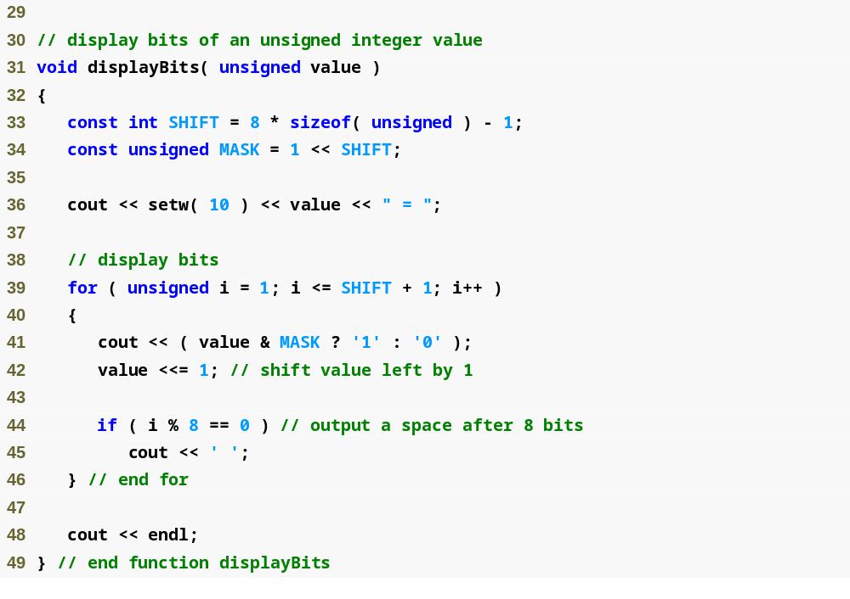
Outline
fig21_11.cpp
(2 of 3)

Slide 48
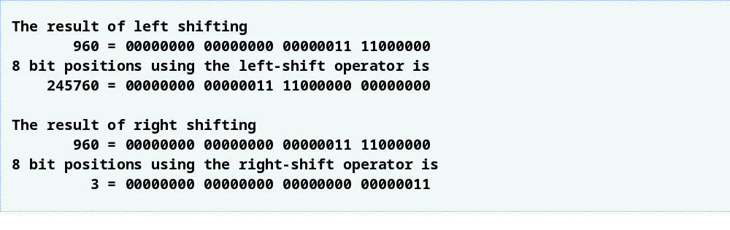
Outline
fig21_11.cpp
(3 of 3)

Slide 49
Common Programming Error 21.5
The result of shifting a value is undefined if the right operand is negative or if the right operand is greater than or equal to the number of bits in which the left operand is stored.

Slide 50
Portability Tip 21.4
The result of right-shifting a signed value is machine dependent. Some machines fill with zeros and others use the sign bit.

Slide 51
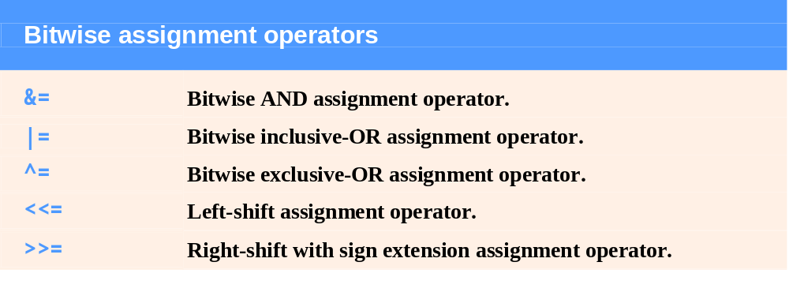
Fig. 21.12 | Bitwise assignment operators.

Slide 52
21.8 Bit Fields
Bit Fields
  Members for which programmer specifies exact number of bits to use to store its value
    Enable better memory utilization by storing data in minimal space
    Must be integral type or enum type member of a class or structure
    Specified width (in bits) of a bit field must be an integer constant

Slide 53
Performance Tip 21.2
Bit fields help conserve storage.

Slide 54
21.8 Bit Fields (Cont.)
Bit Fields (Cont.)
  Example
    struct BitCard
    {
    unsigned face : 4;
    unsigned suit : 2;
    unsigned color : 1;
    };
  unsigned variable face is stored in 4 bits
  unsigned variable suit is stored in 2 bits
  unsigned variable color is stored in 1 bit

Slide 55
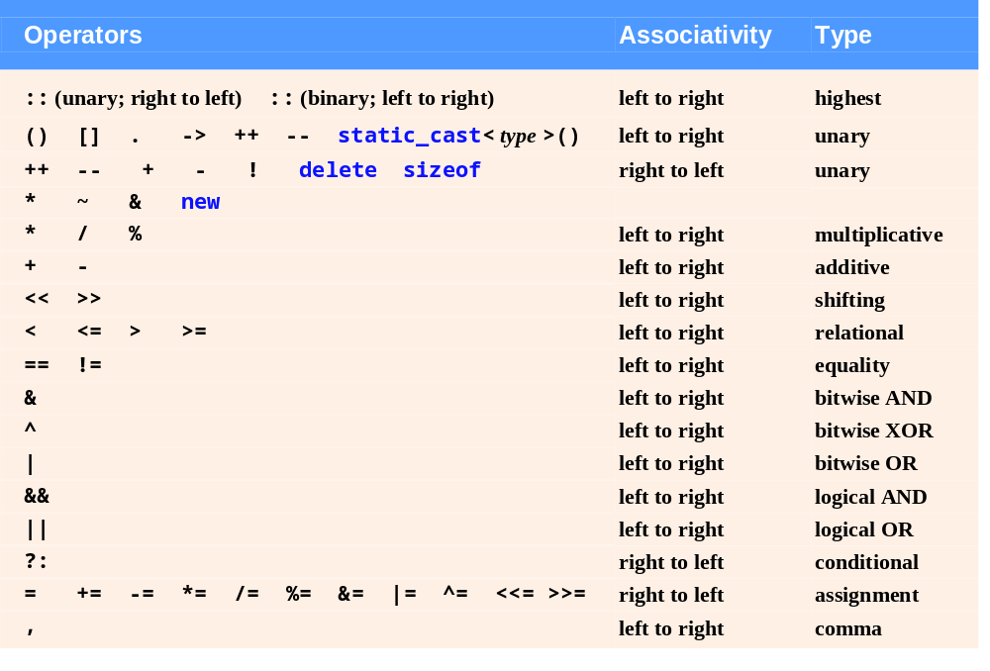
Fig. 21.13 | Operator precedence and associativity.

Slide 56
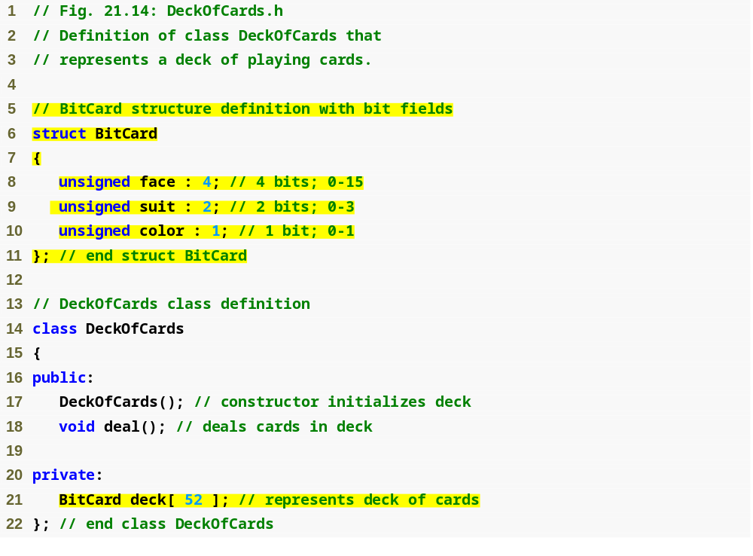
Outline
DeckOfCards.h
(1 of 1)
Declare bit fields face, suit and color
Create array deck containing 52 BitCard structure variables

Slide 57
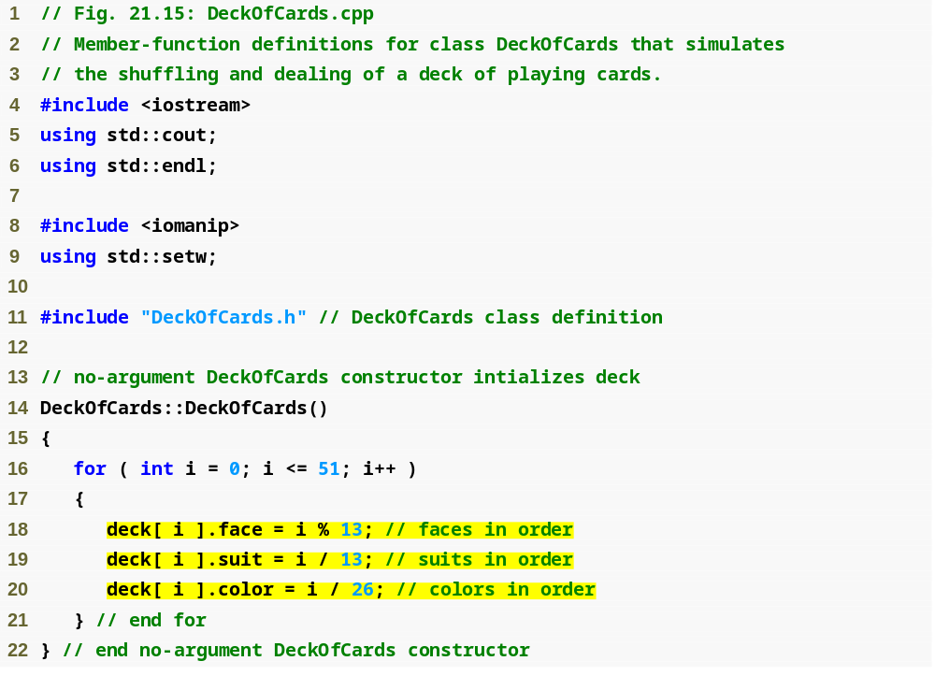
Outline
DeckOfCards.cpp
(1 of 2)
Insert the 52 cards in the deck array

Slide 58
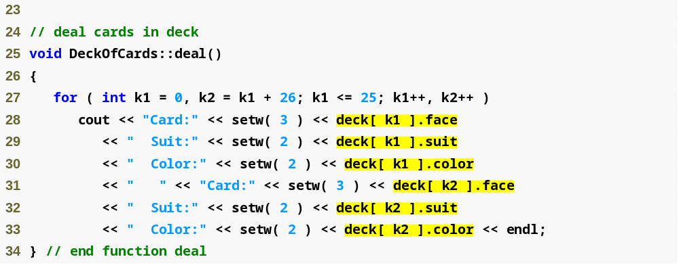
Outline
Print the 52 cards, accessing the bit fields exactly as any other member
DeckOfCards.cpp
(2 of 2)

Slide 59
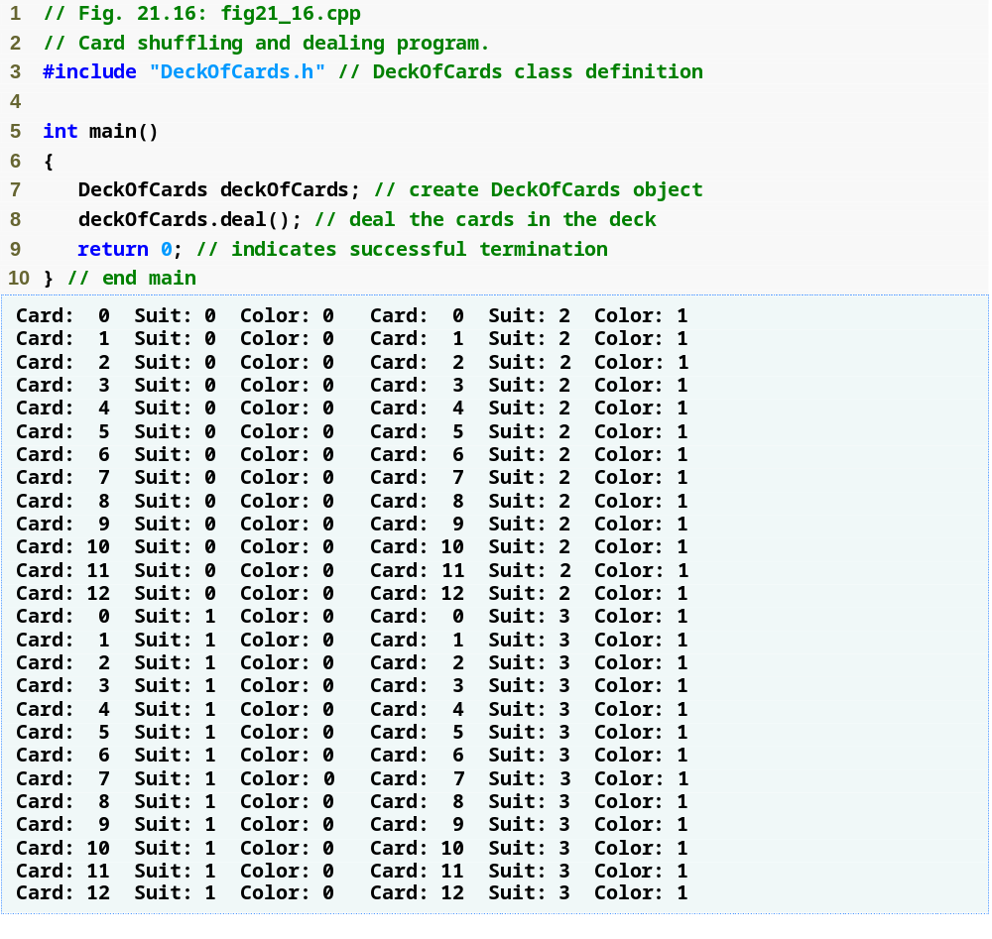
Outline
fig21_16.cpp
(1 of 1)

Slide 60
21.8 Bit Fields (Cont.)
Bit Fields (Cont.)
  Unnamed bit fields
    Are used as padding
    Example
      unsigned a : 13;
      unsigned : 3;
      unsigned b : 4;
    Nothing can be stored in unnamed 3-bit field
    Member b is stored in another storage unit

Slide 61
21.8 Bit Fields (Cont.)
Bit Fields (Cont.)
  Unnamed bit fields with zero width
    Align next bit field on new storage-unit boundary
    Example
      unsigned a : 13;
      unsigned : 0;
      unsigned b : 4;
    Skips remaining bits in a’s storage unit
    Member b is aligned on next storage-unit boundary

Slide 62
Portability Tip 21.5
Bit-field manipulations are machine dependent. For example, some computers allow bit fields to cross word boundaries, whereas others do not.

Slide 63
Common Programming Error 21.6
Attempting to access individual bits of a bit field with subscripting as if they were elements of an array is a compilation error. Bit fields are not “arrays of bits.”

Slide 64
Common Programming Error 21.7
Attempting to take the address of a bit field (the & operator may not be used with bit fields because a pointer can designate only a particular byte in memory and bit fields can start in the middle of a byte) is a compilation error.

Slide 65
Performance Tip 21.3
Although bit fields save space, using them can cause the compiler to generate slower-executing machine-language code. This occurs because it takes extra machine-language operations to access only portions of an addressable storage unit. This is one of many examples of the space-time trade-offs that occur in computer science.

Slide 66
21.9 Character-Handling Library
Character-handling library functions
  Perform useful tests and manipulations of character data
  Manipulates characters as ints
    char cannot store EOF (usually -1)
    All functions take an int argument and return an int
  Included in <cctype> header file

Slide 67
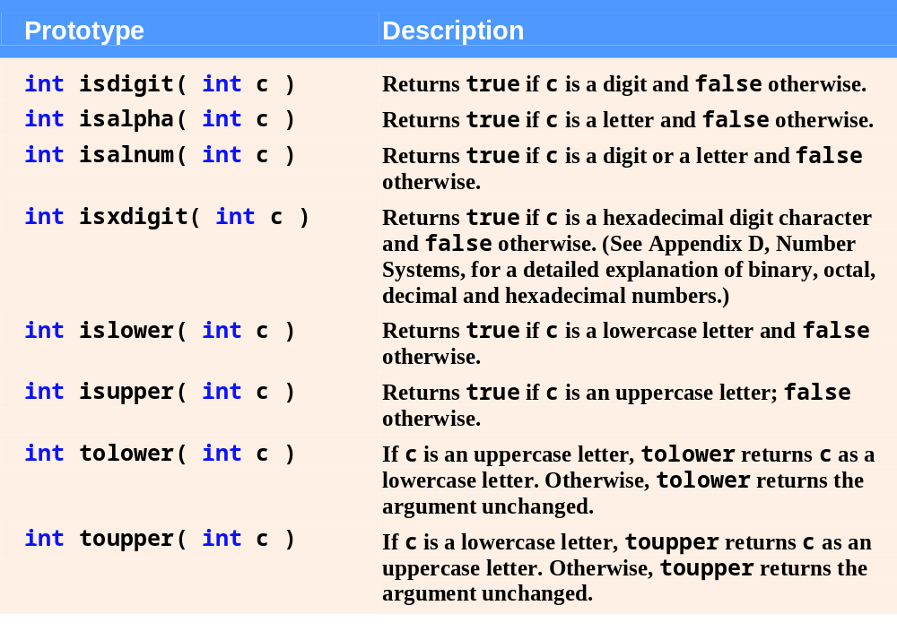
Fig. 21.17 | Character-handling library functions. (Part 1 of 2)

Slide 68
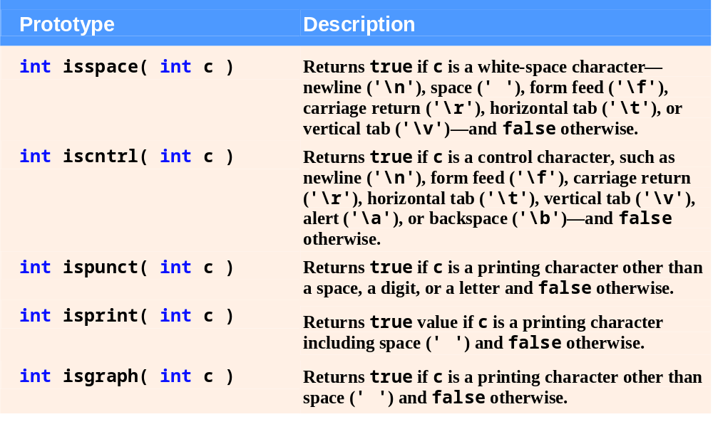
Fig. 21.17 | Character-handling library functions. (Part 2 of 2)

Slide 69
21.9 Character-Handling Library (Cont.)
Character-handling library functions (Cont.)
  Function isdigit
    Returns true if argument is a digit (0-9)
  Function isalpha
    Returns true if argument is an uppercase or lowercase letter (A-Z, a-z)
  Function isalnum
    Returns true if argument is an uppercase letter, lowercase letter or digit (A-Z, a-z, 0-9)
  Function isxdigit
    Returns true if argument is a hexadecimal digit (A-F, a-f, 0-9)

Slide 70
21.9 Character-Handling Library (Cont.)
Character-handling library functions (Cont.)
  Function islower
    Returns true if argument is a lowercase letter (a-z)
  Function isupper
    Returns true if argument is an uppercase letter (A-Z)
  Function tolower
    Returns its uppercase-letter argument as a lowercase letter
    Returns its argument unchanged if it is not an uppercase letter
  Function toupper
    Returns its lowercase-letter argument as an uppercase letter
    Returns its argument unchanged if it is not a lowercase letter

Slide 71
21.9 Character-Handling Library (Cont.)
Character-handling library functions (Cont.)
  Function isspace
    Returns true if argument is a white-space character
      Such as space (' '), form feed ('\f'), newline ('\n'), carriage return ('\r'), horizontal tab ('\t'), vertical tab ('\v')
  Function iscntrl
    Returns true if argument is a control character
      Such as horizontal tab ('\t'), vertical tab ('\v'), form feed ('\f'), alert ('\a'), backspace ('\b'), carriage return ('\r'), newline ('\n')

Slide 72
21.9 Character-Handling Library (Cont.)
Character-handling library functions (Cont.)
  Function ispunct
    Returns true if argument is a printing character other than a space, digit or letter
      Such as $, #, (, ), [, ], {, }, ;, : or %
  Function isprint
    Returns true if argument is a displayable character (including the space character)
  Function isgraph
    Returns true if argument is a graphical, displayable character (not including the space character)

Slide 73
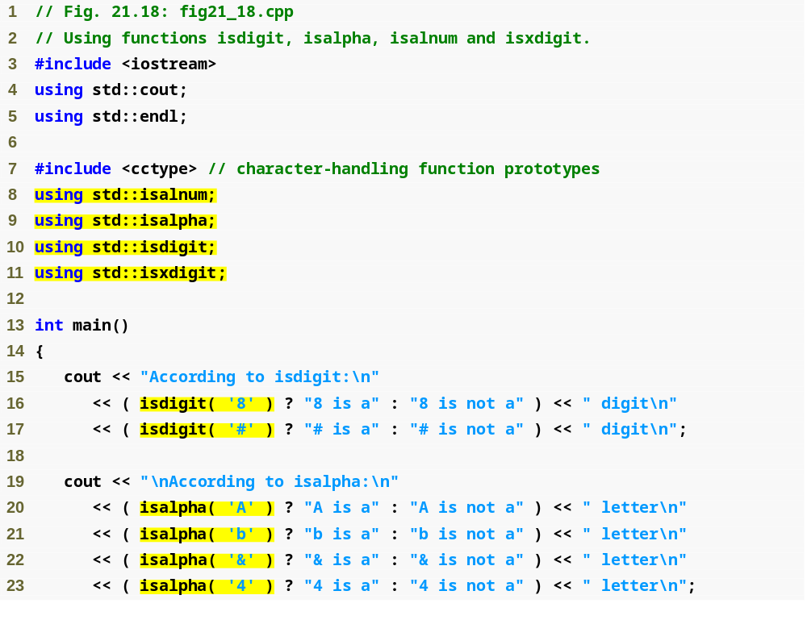
Outline
fig21_18.cpp
(1 of 3)
Use the conditional operator (?:) with the return value of each function to determine the correct string to print

Slide 74
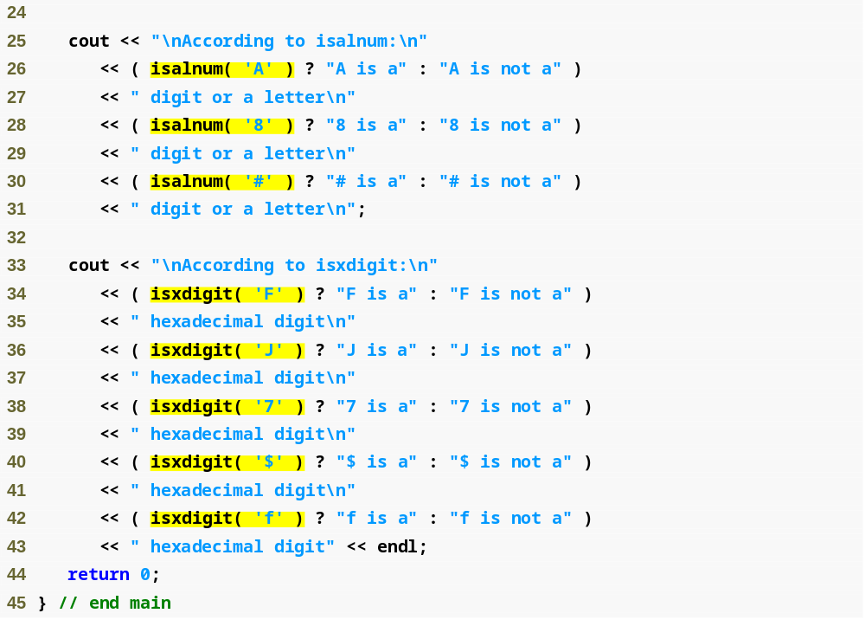
Outline
fig21_18.cpp
(2 of 3)

Slide 75
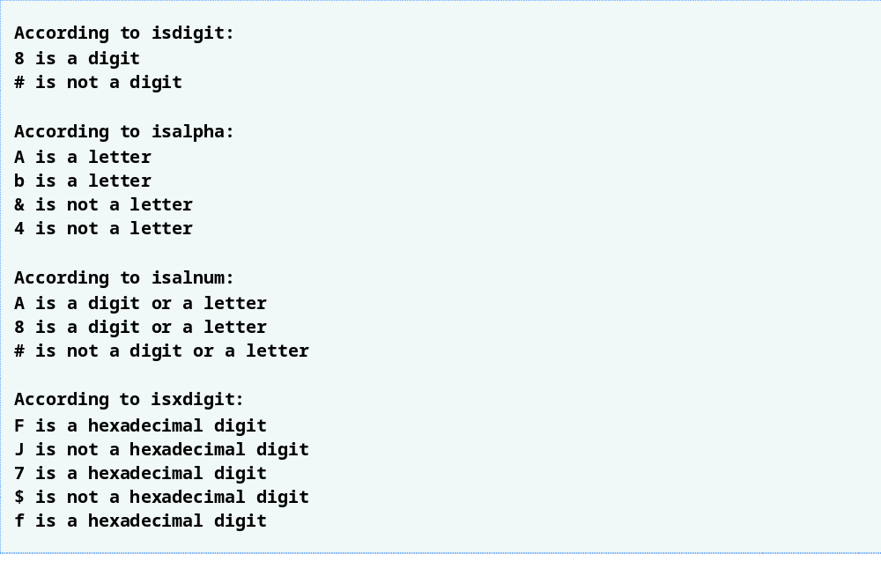
Outline
fig21_18.cpp
(3 of 3)

Slide 76
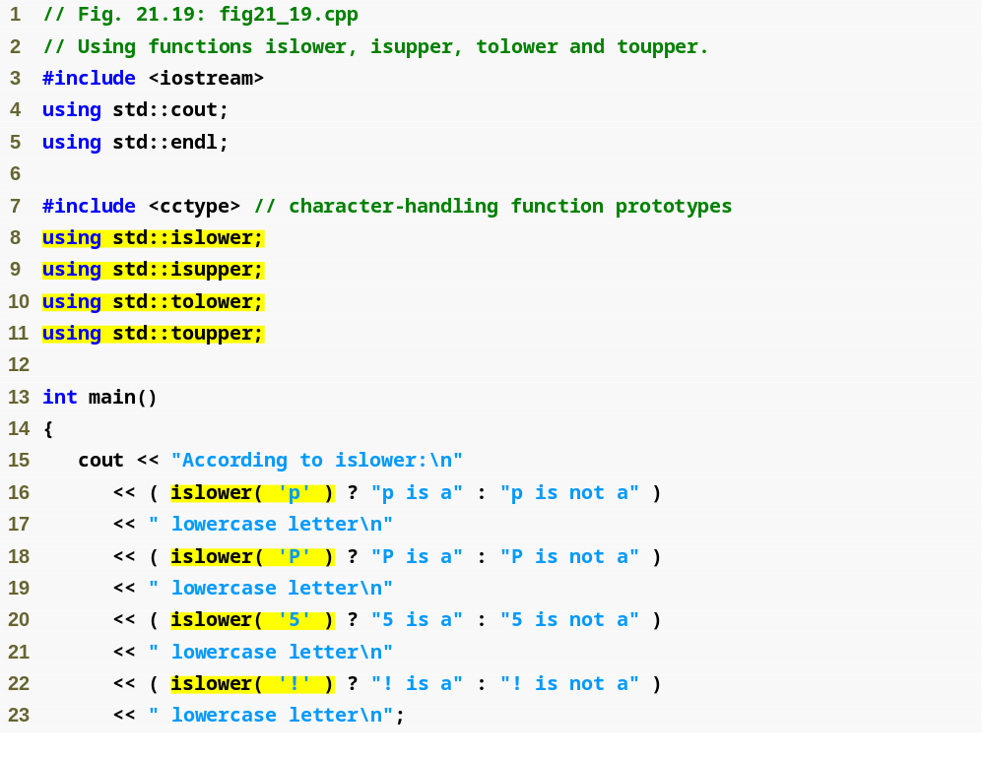
Outline
fig21_19.cpp
(1 of 3)

Slide 77
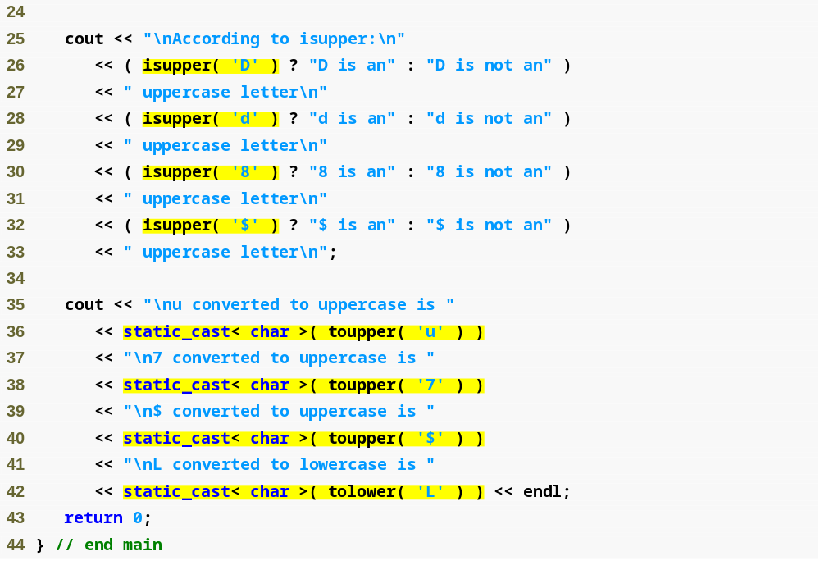
Outline
fig21_19.cpp
(2 of 3)

Slide 78
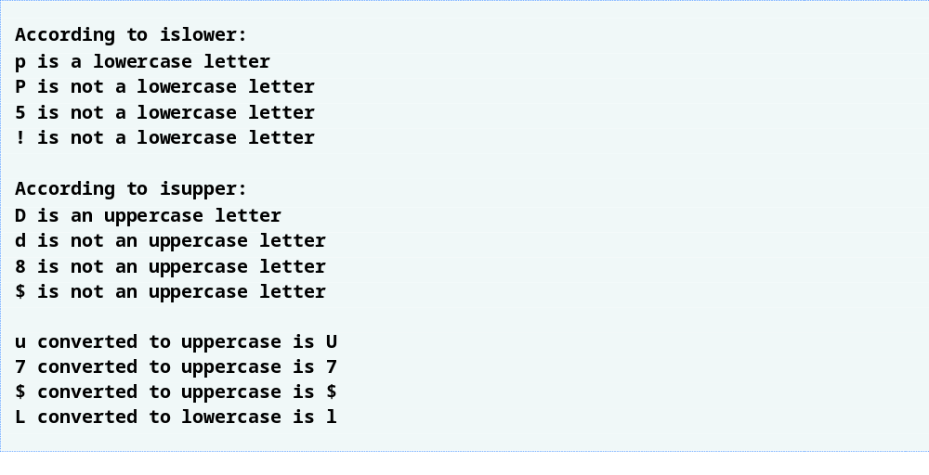
Outline
fig21_19.cpp
(3 of 3)

Slide 79
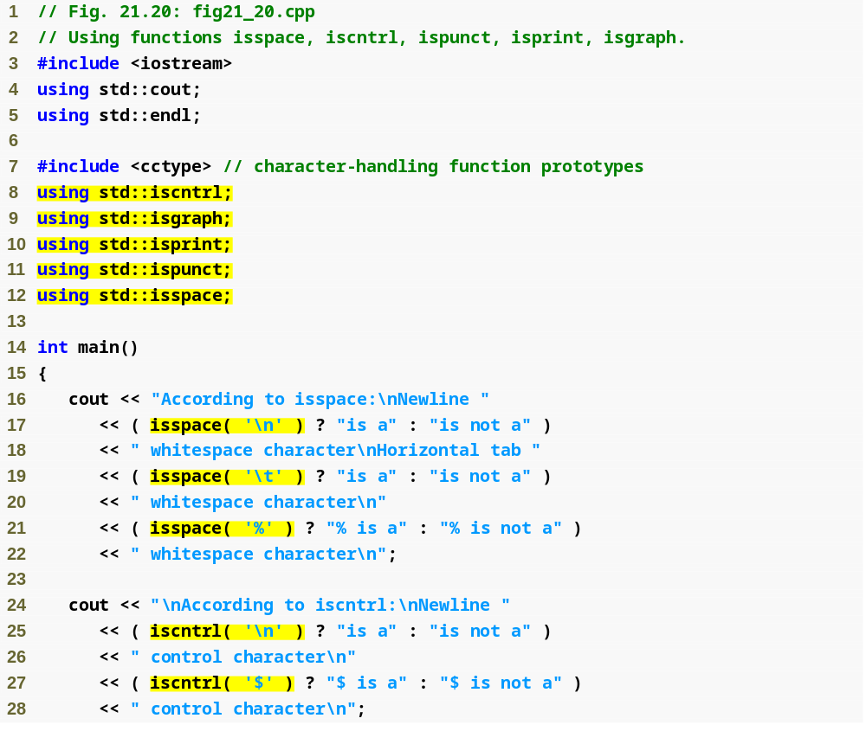
Outline
fig21_20.cpp
(1 of 3)

Slide 80
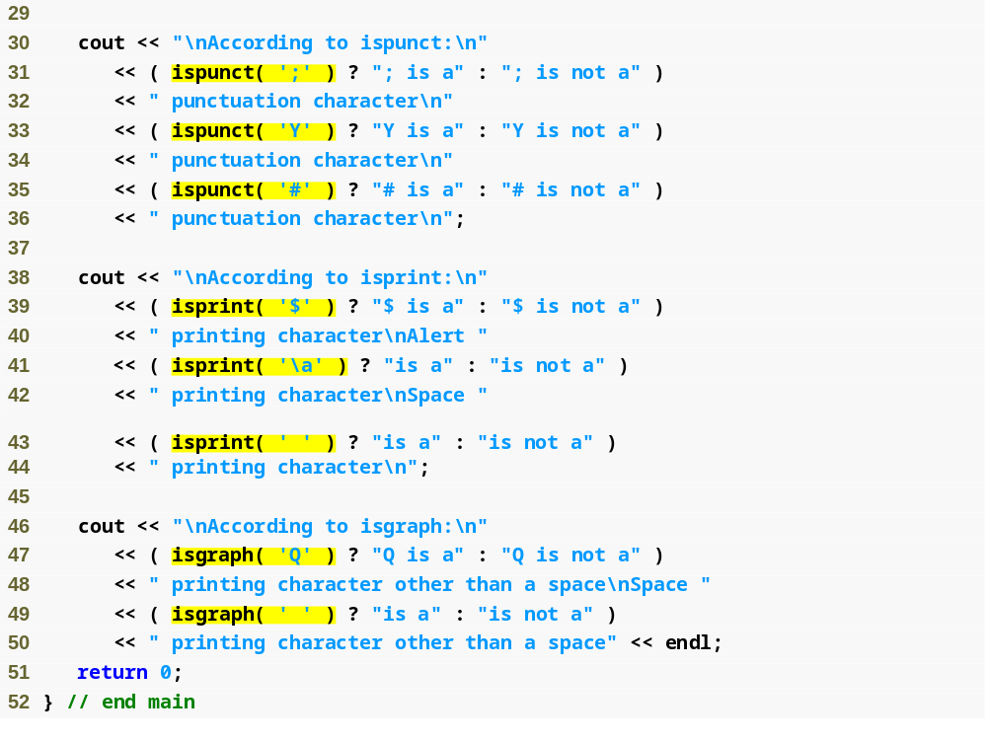
Outline
fig21_20.cpp
(2 of 3)

Slide 81
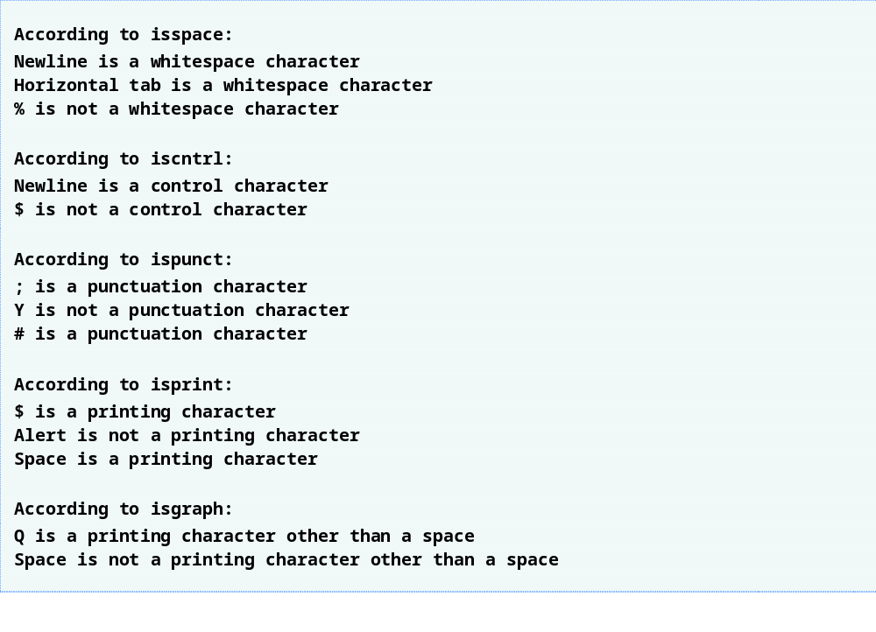
Outline
fig21_20.cpp
(3 of 3)

Slide 82
21.10 Pointer-Based String-Conversion Functions
Pointer-based string-conversion functions
  Convert pointer-based strings of characters to integer and floating-point values
    Return 0 if their string arguments cannot be converted
  Included in general-utilities library <cstdlib>

Slide 83
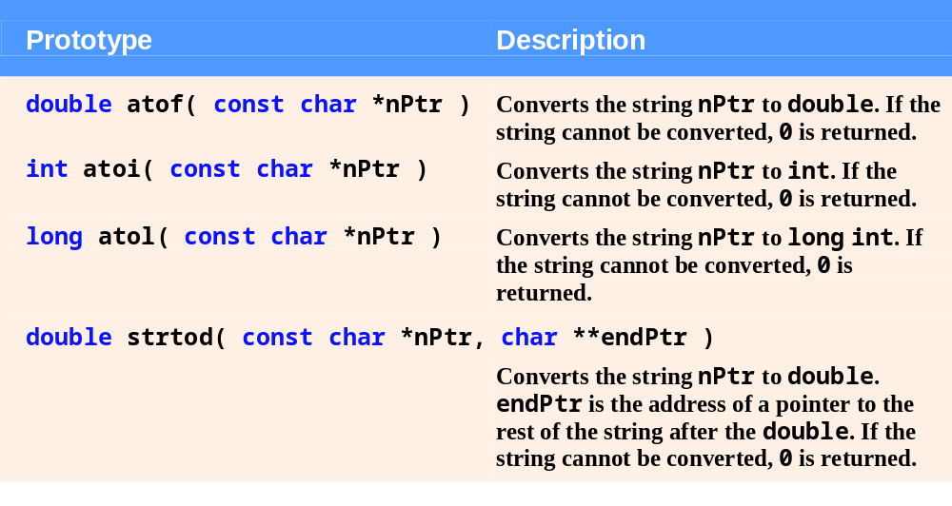
Fig. 21.21 | Pointer-based string-conversion functions of the general-utilities library. (Part 1 of 2)

Slide 84
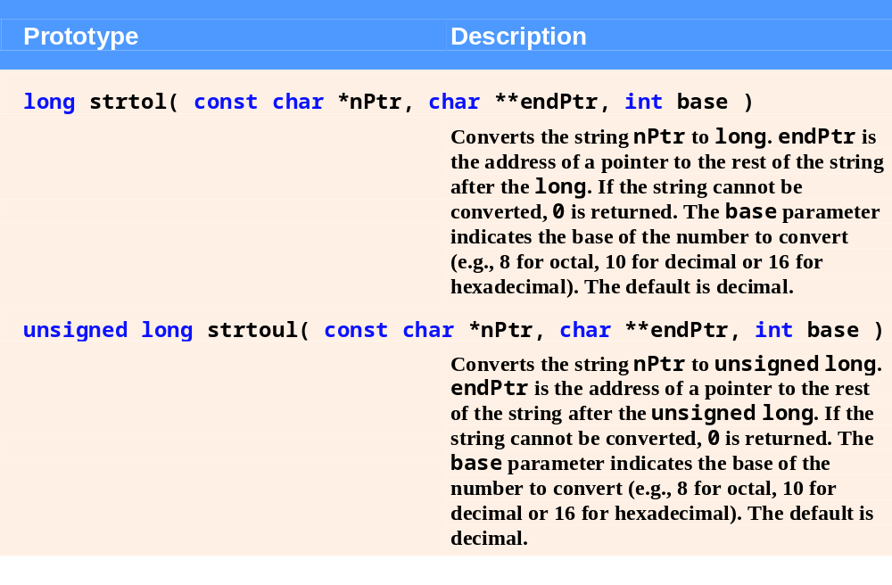
Fig. 21.21 | Pointer-based string-conversion functions of the general-utilities library. (Part 2 of 2)

Slide 85
21.10 Pointer-Based String-Conversion Functions (Cont.)
Pointer-based string-conversion functions (Cont.)
  Function atof
    Converts string argument to a double value
  Function atoi
    Converts string argument to an int value
  Function atol
    Converts string argument to a long value
  Function strtod
    Converts a sequence of characters to a double value
    Second argument specifies a char ** pointer
      Sets the char * at that address to point to the location of the first character after the converted portion

Slide 86
21.10 Pointer-Based String-Conversion Functions (Cont.)
Pointer-based string-conversion functions (Cont.)
  Function strtoul
    Converts a sequence of characters to an unsigned long value
    Second argument specifies a char ** pointer
      Sets the char * at that address to point to the location of the first character after the converted portion
    Third argument specifies the value’s base
      0 specifies octal, decimal or hexadecimal, depending on the initial character(s) – 0 for octal, 0x for hexadecimal and 1-9 for decimal
      2-36 specify that value for the base
        For bases 11-36, characters A-Z represent values 10 to 35

Slide 87
21.10 Pointer-Based String-Conversion Functions (Cont.)
Pointer-based string-conversion functions (Cont.)
  Function strtol
    Converts a sequence of characters to a long value
    Second argument specifies a char ** pointer
      Sets the char * at that address to point to the location of the first character after the converted portion
    Third argument specifies the value’s base
      0 specifies octal, decimal or hexadecimal, depending on the initial character(s) – 0 for octal, 0x for hexadecimal and 1-9 for decimal
      2-36 specify that value for the base
        For bases 11-36, characters A-Z represent values 10 to 35

Slide 88
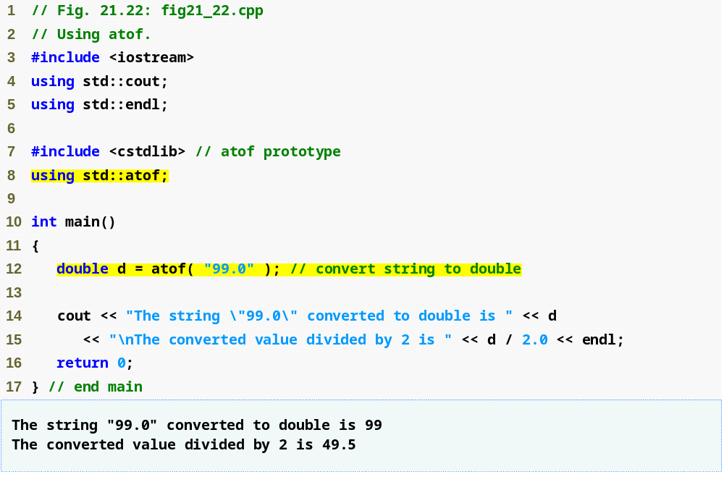
Outline
fig21_22.cpp
(1 of 1)
Convert a string that represents a floating-point number to a double value

Slide 89
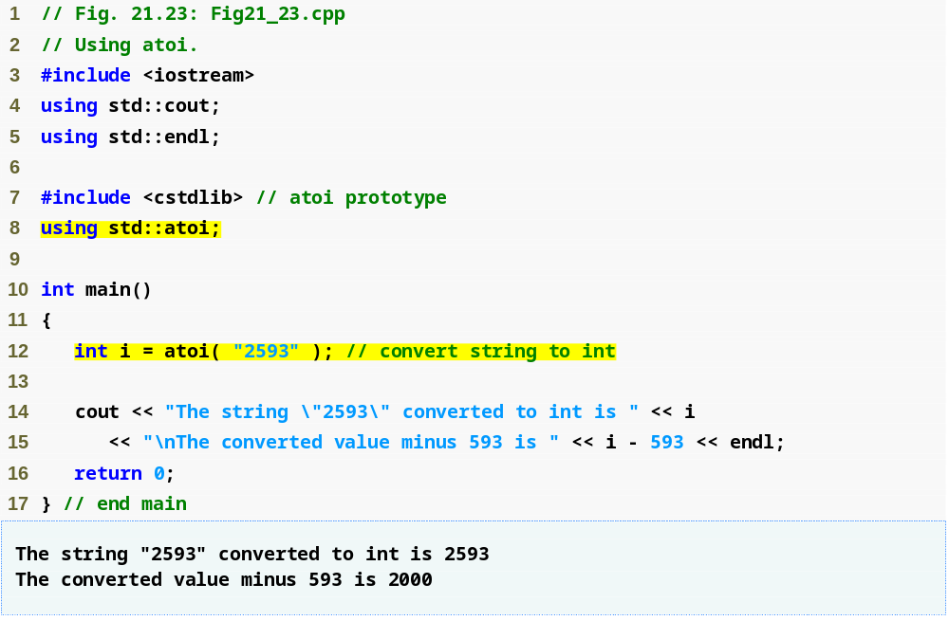
Outline
Fig21_23.cpp
(1 of 1)
Convert a string of digits that represents an integer to an int value

Slide 90
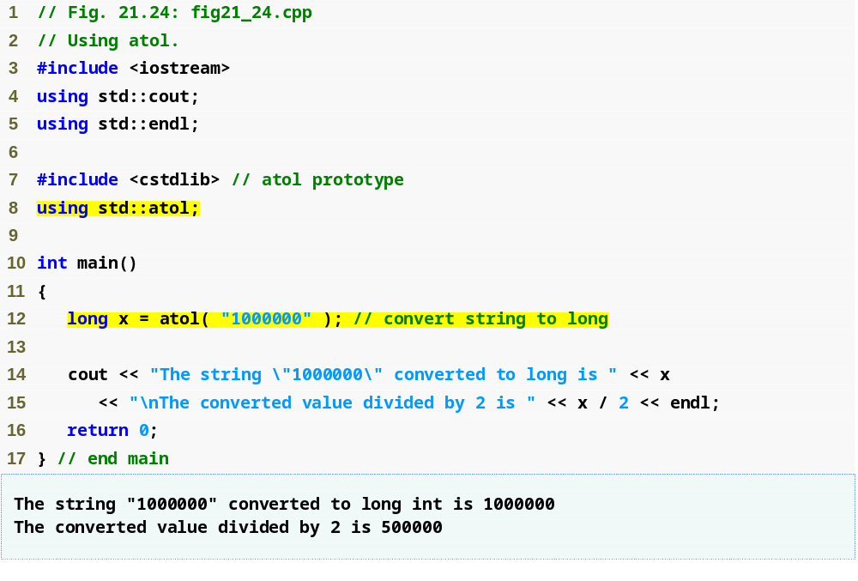
Outline
fig21_24.cpp
(1 of 1)
Convert a string of digits representing a long integer to a long value

Slide 91
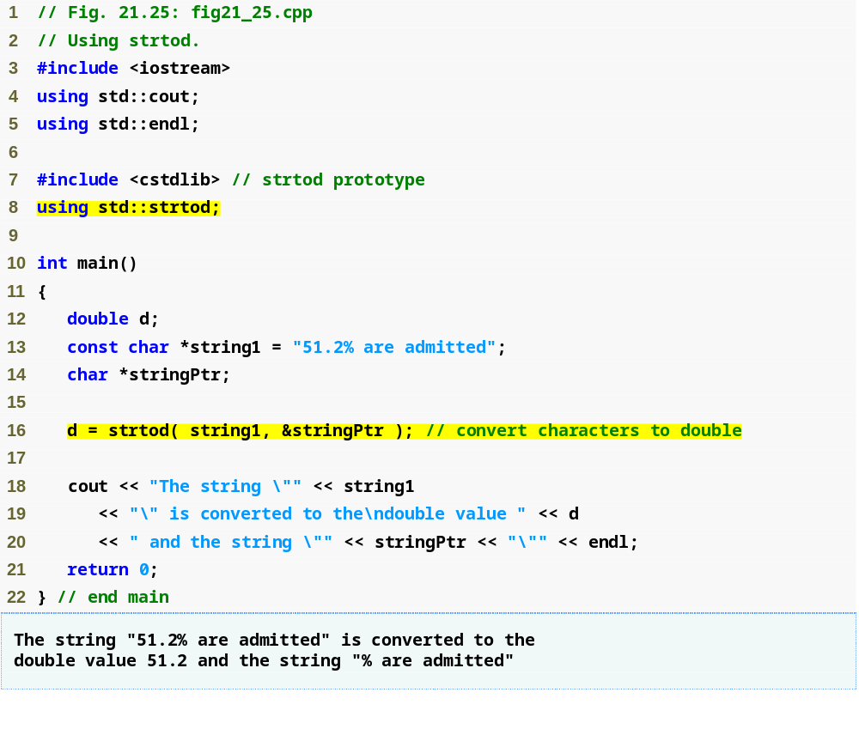
Outline
fig21_25.cpp
(1 of 1)
Convert a double value from the beginning of string1
Display the remainder of the string after the converted portion

Slide 92
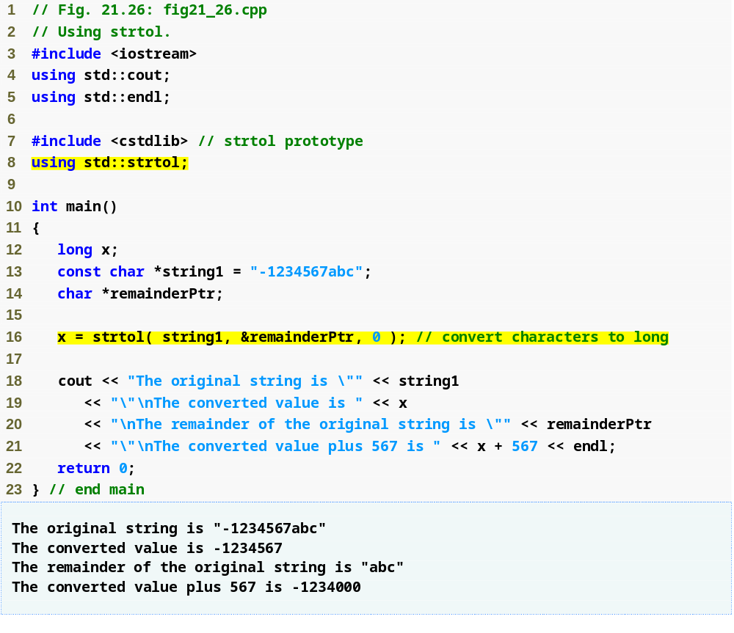
Outline
fig21_26.cpp
(1 of 1)
Convert a sequence of characters representing an integer to a long value
Third argument 0 indicates decimal base because the initial character is '1'
Display remainder of the string after the converted portion

Slide 93
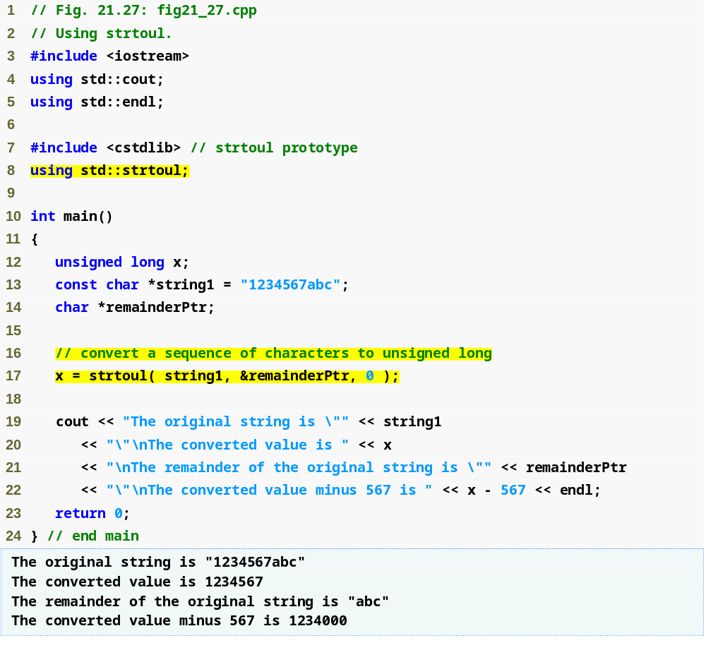
Outline
fig21_27.cpp
(1 of 1)
Convert a sequence of characters representing an unsigned long integer to an unsigned long value
Indicate that the value to be converted can be in octal, decimal or hexadecimal format, depending on the initial characters
Display the remainder of the string after the converted portion

Slide 94
21.11 Search Functions of the Pointer-Based String-Handling Library
Pointer-based string search functions
  Used to search strings for characters and other strings
  size_t
    Defined as the integral type of the value returned by operator sizeof

Slide 95
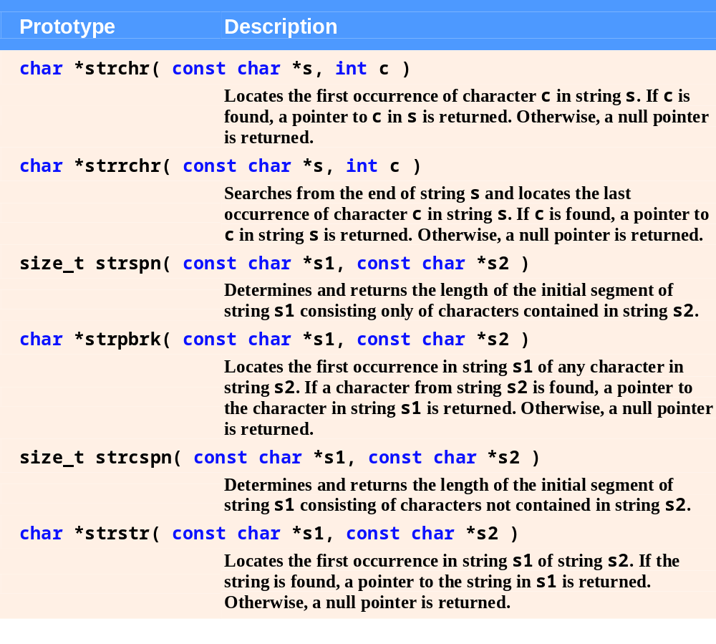
Fig. 21.28 | Search functions of the pointer-based string-handling library.

Slide 96
21.11 Search Functions of the Pointer-Based String-Handling Library (Cont.)
Pointer-based string search functions (Cont.)
  Function strchr
    Searches for the first occurrence of a character in a string
      Returns pointer to the character if it is found
      Otherwise, returns null pointer
  Function strcspn
    Returns length of the initial part of the first string argument that does not contain any character from the second string argument

Slide 97
21.11 Search Functions of the Pointer-Based String-Handling Library (Cont.)
Pointer-based string search functions (Cont.)
  Function strpbrk
    Searches for the first occurrence in the first string argument of any character in the second string argument
      Returns pointer to the character if one is found
      Otherwise, returns null pointer
  Function strrchr
    Searches for the last occurrence of a character in a string
      Returns pointer to the character if one is found
      Otherwise, returns null pointer

Slide 98
21.11 Search Functions of the Pointer-Based String-Handling Library (Cont.)
Pointer-based string search functions (Cont.)
  Function strspn
    Returns length of the initial part of the first string argument that contains only characters from the second string argument
  Function strstr
    Searches for the first occurrence of the second string argument in the first string argument
      Returns pointer to the substring if one is found
      Otherwise, returns null pointer

Slide 99
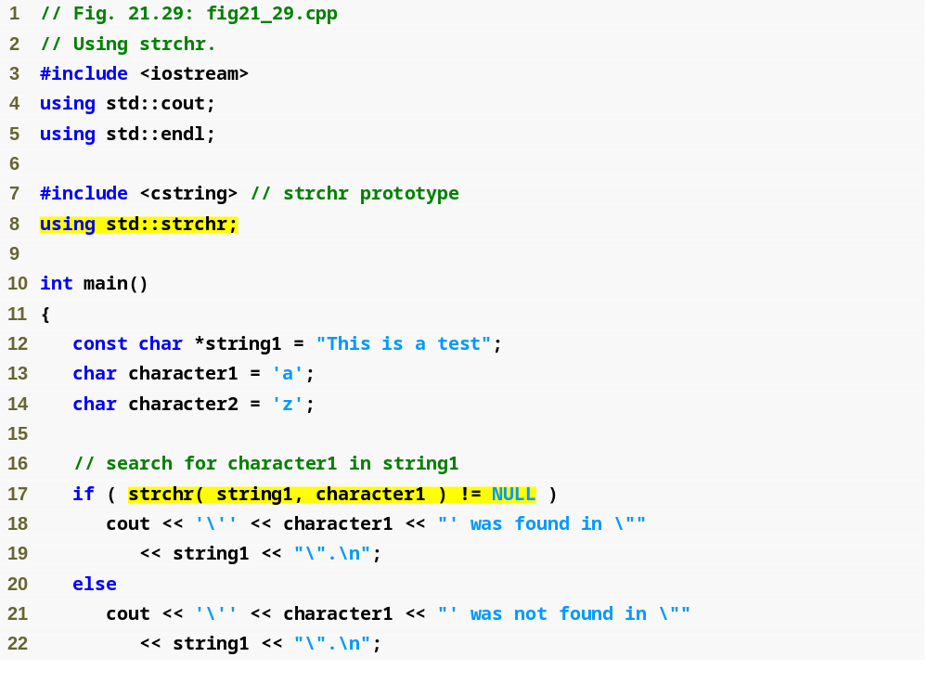
Outline
fig21_29.cpp
(1 of 2)
Search for the first occurrence of 'a' in the string "This is a test"

Slide 100
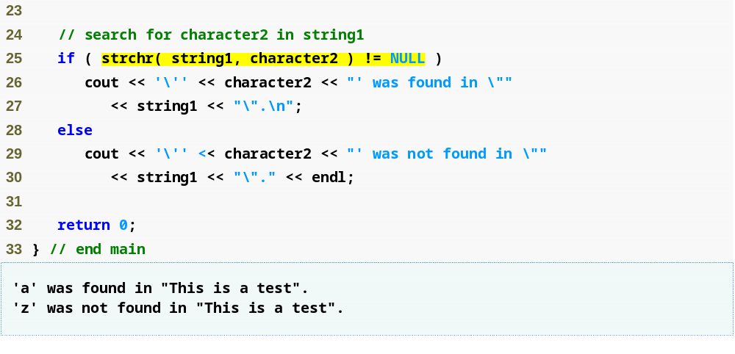
Outline
Search for the first occurrence of 'z' in the string "This is a test"
fig21_29.cpp
(2 of 2)

Slide 101
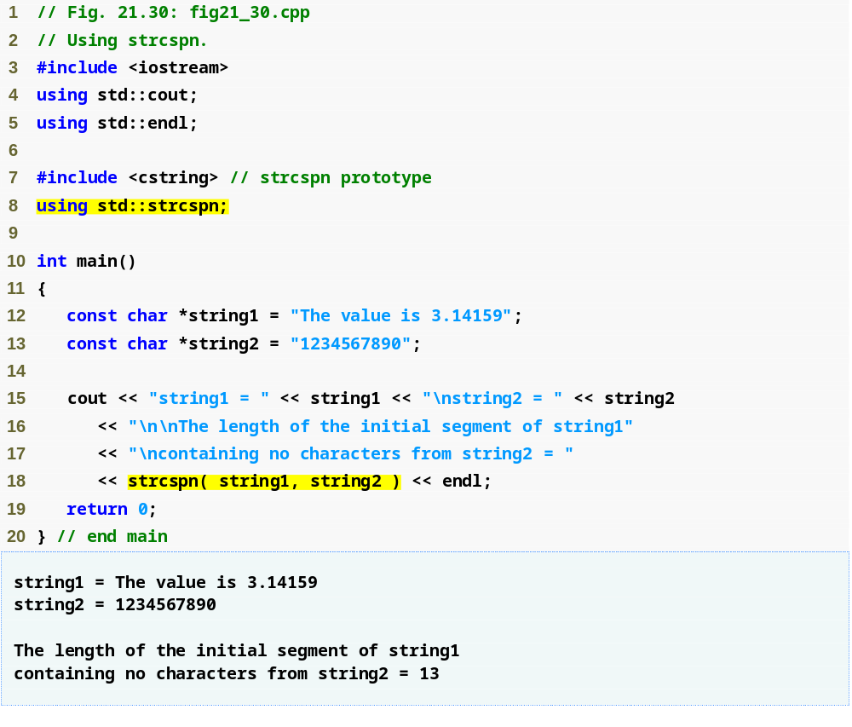
Outline
fig21_30.cpp
(1 of 1)
Determine the length of the initial part of "The value is 3.14159" that does not contain any characters from "1234567890"

Slide 102
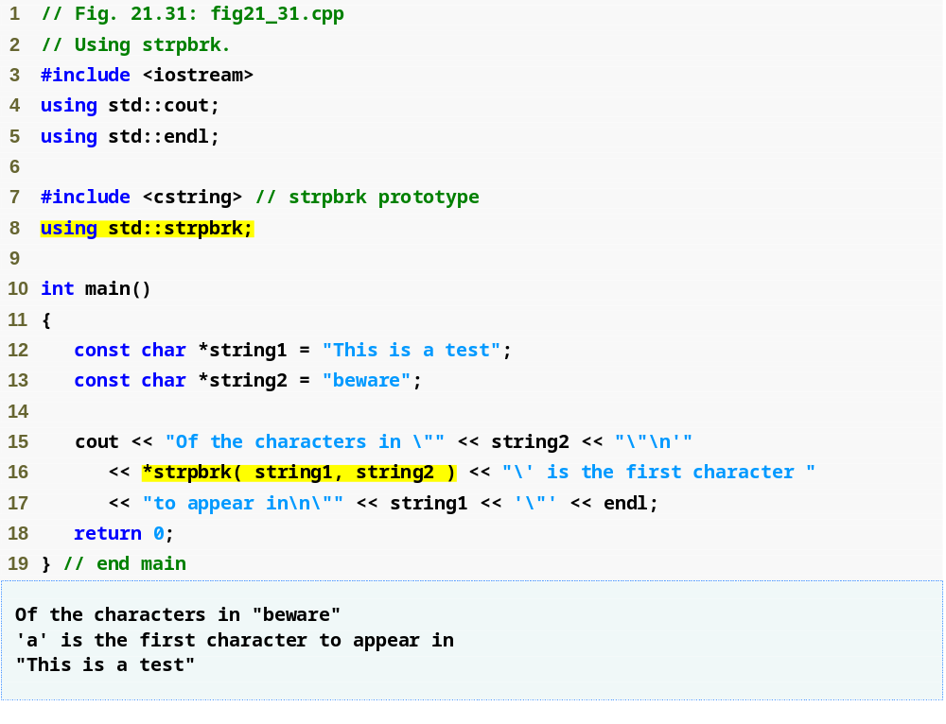
Outline
fig21_31.cpp
(1 of 1)
Search for the first occurrence in "This is a test" of any character in "beware"

Slide 103
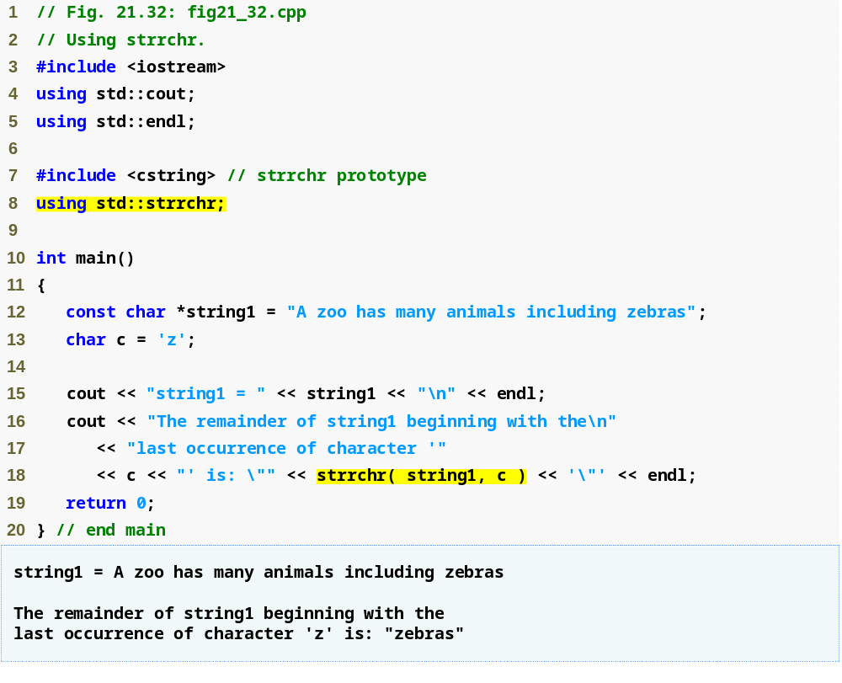
Outline
fig21_32.cpp
(1 of 1)
Search for the last occurrence of 'z' in "A zoo has many animals including zebras"

Slide 104

Outline
fig21_33.cpp
(1 of 1)
Determine the length of the initial part of "The value is 3.14159" that contains only characters from "aehils Tuv"

Slide 105

Outline
fig21_34.cpp
(1 of 1)
Search for the first occurrence of "def" in "abcdefabcdef"

Slide 106
21.12 Memory Functions of the Pointer-Based String-Handling Library
Pointer-based string memory functions
  Facilitate manipulating, comparing and searching blocks of memory
    Treat blocks of memory as arrays of bytes
      Referred to as “objects”
    Can manipulate any block of data
      Use arguments of type void *
        Any pointer can be converted to type void *

Slide 107

Fig. 21.35 | Memory functions of the string-handling library.

Slide 108
21.12 Memory Functions of the Pointer-Based String-Handling Library (Cont.)
Pointer-based string memory functions (Cont.)
  Function memcpy
    Copies specified number of bytes from the second object into the first object
    Undefined if the two objects overlap in memory
  Function memmove
    Copies specified number of bytes from the second object into the first object
      Performed as if the bytes were first copied to temporary storage
    Can be used even if the two objects overlap in memory

Slide 109
21.12 Memory Functions of the Pointer-Based String-Handling Library (Cont.)
Pointer-based string memory functions (Cont.)
  Function memcmp
    Compares specified number of bytes in the first object with the corresponding bytes in the second object
      Returns positive value if first object is greater
      Returns zero if both objects are equal
      Returns negative value if first object is less
  Function memchr
    Searches for the first occurrence of the specified byte (unsigned char) in the specified number of bytes of an object
      Returns pointer to the byte if one is found
      Otherwise, returns null pointer

Slide 110
21.12 Memory Functions of the Pointer-Based String-Handling Library (Cont.)
Pointer-based string memory functions (Cont.)
  Function memset
    Copies specified byte value into the specified number of bytes of an object

Slide 111

Outline
fig21_36.cpp
(1 of 1)
Copy the string in array s2 to array s1

Slide 112
Common Programming Error 21.8
String-manipulation functions other than memmove that copy characters have undefined results when copying takes place between parts of the same string.

Slide 113

Outline
fig21_37.cpp
(1 of 1)
Copy the last 10 bytes of array x into the first 10 bytes of array x

Slide 114

Outline
fig21_38.cpp
(1 of 1)
Compare bytes in s1 with bytes in s2

Slide 115

Outline
fig21_39.cpp
(1 of 1)
Search for 'r' in "ring"

Slide 116

Outline
fig21_40.cpp
(1 of 1)
Copy 'b' into the first 7 bytes of string1

